Slide 1
Diabetes Prediction Dataset
Group Members:
PRATHAM SAPRA : 101572630
BISHAKHA : 101547832
HENSEL MARVI AGGARAO : 101544174
NAHID NASERI : 101518575
VRUNAL PATEL : 101574257
JAMES DOMINIC BELIZARIO : 101396978
STEPHEN LU : 100646328
BHOOMIKA PATEL : 101595094
ADAM DANIEL JENAH : 100970401

Slide 2
Introduction
Dataset from the National Institute of Diabetes and Digestive and Kidney Diseases.
Objective: Predict diabetes diagnosis based on medical and demographic information.
Independent Variables (Predictors):
Pregnancies: Number of times pregnant.
Glucose: Plasma glucose concentration (mg/dL).
BloodPressure: Diastolic blood pressure (mm Hg).
SkinThickness: Triceps skinfold thickness (mm).
Insulin: 2-hour serum insulin (μU/mL).
BMI: Body mass index (kg/m²).
DiabetesPedigreeFunction: Likelihood based on family history.
Age: Patient’s age (years).
Dependent Variable (Target):
Outcome: Binary classification
0 = Non-diabetic
1 = Diabetic

Slide 3
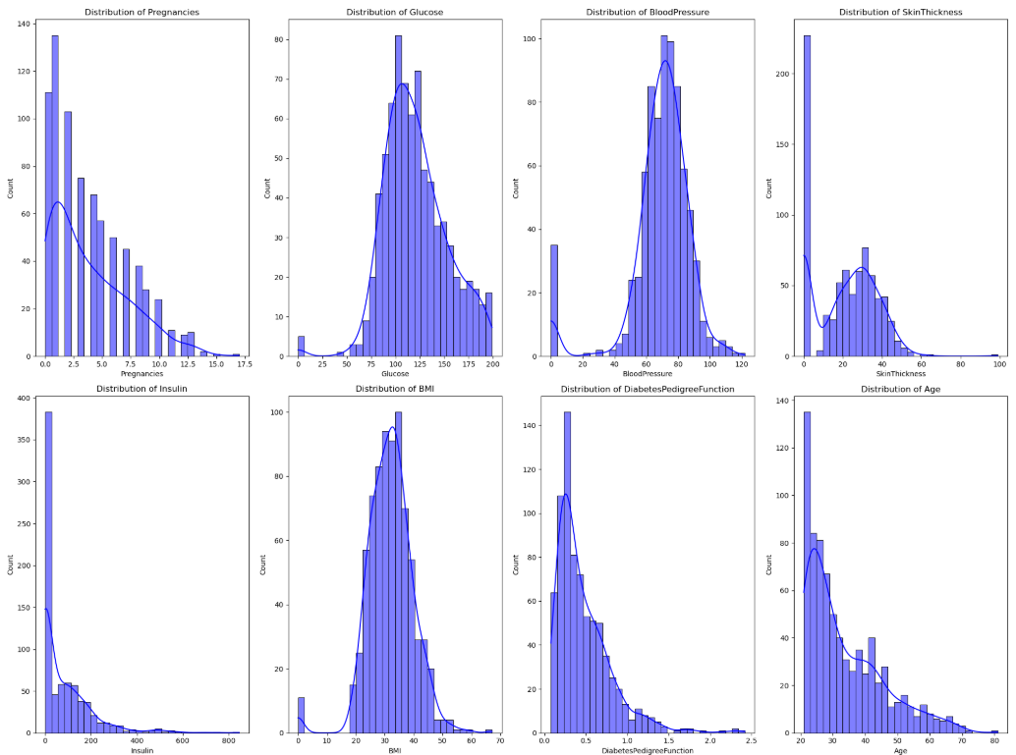
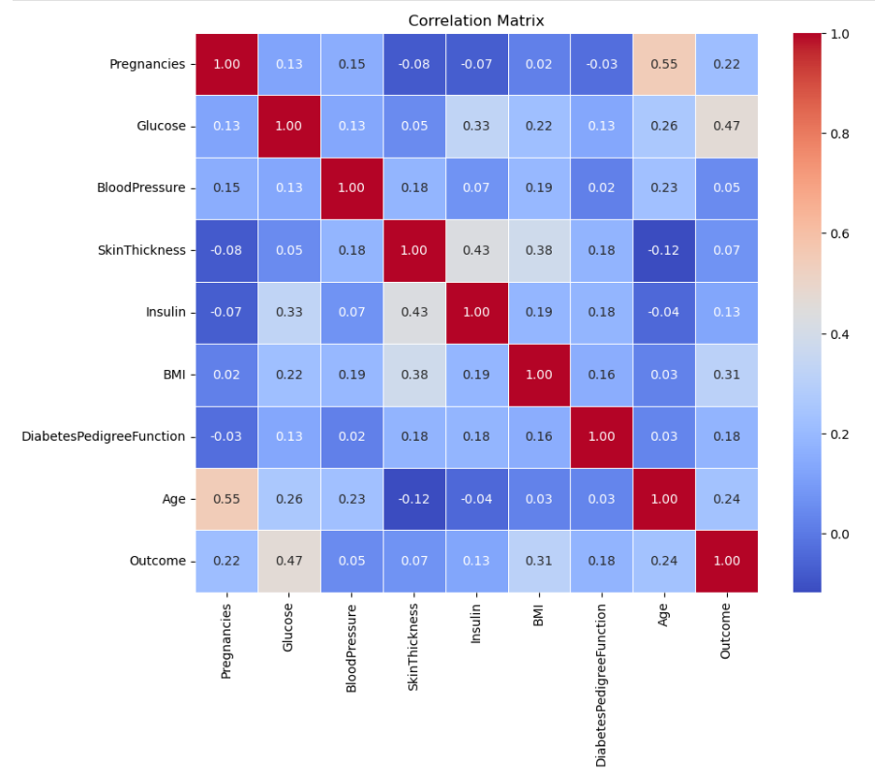
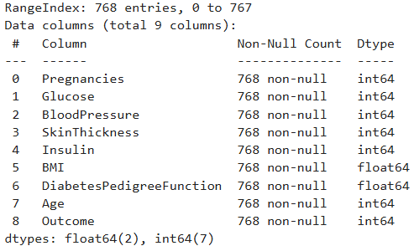
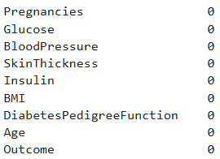

Data Pre-Processing

Slide 4
Logistic Regression
Data contained 757 instances and 9 features, with balanced target classes achieved through SMOTE (50:50).
Diabetes Outcome (Positive/Negative)
Distribution of key features like Age, Glucose, BMI visualized.
Correlation heatmap showed feature relationships; Glucose and BMI had stronger correlations with Outcome.
Feature Selection:
Applied Recursive Feature Elimination (RFECV) with Logistic Regression to identify top features.
Optimal features: Pregnancies, Glucose, BMI, DiabetesPedigreeFunction.
Cross-validation score peaked at 4 features.
Model Evaluation:
Average Accuracy (K-fold): 73.02%.
Confusion Matrix showed balanced performance:
Precision: ~73%. Recall: ~73%. AUC Score: 82.81%, indicating good model discrimination.

Slide 5
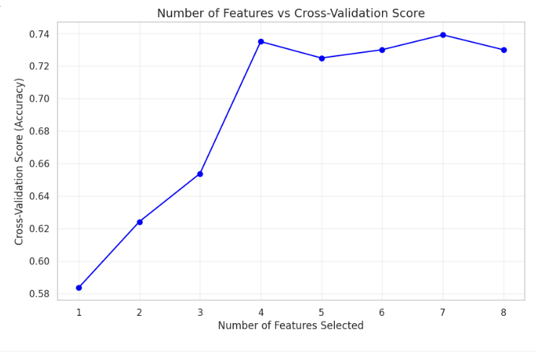
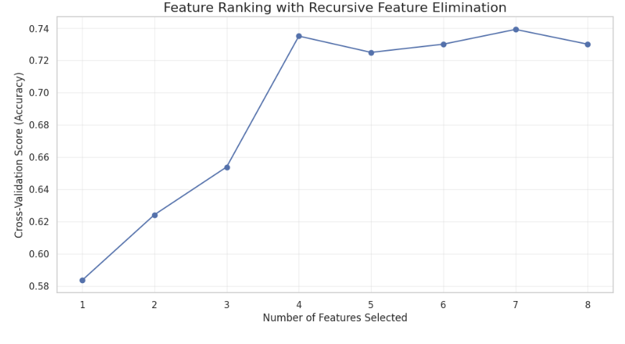
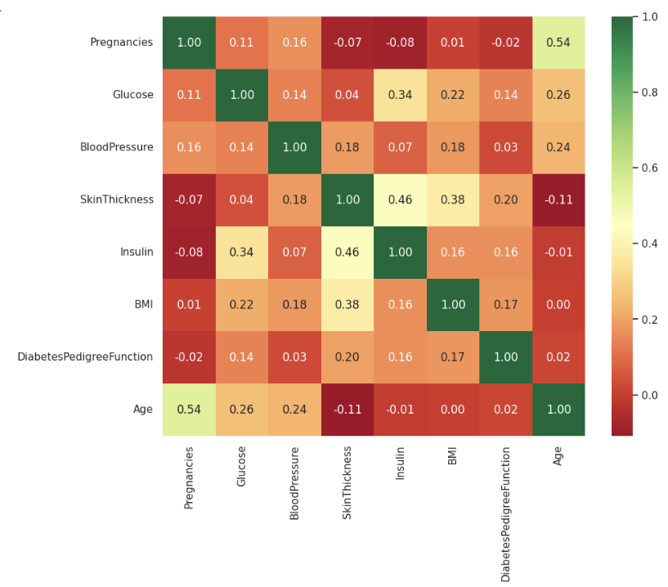
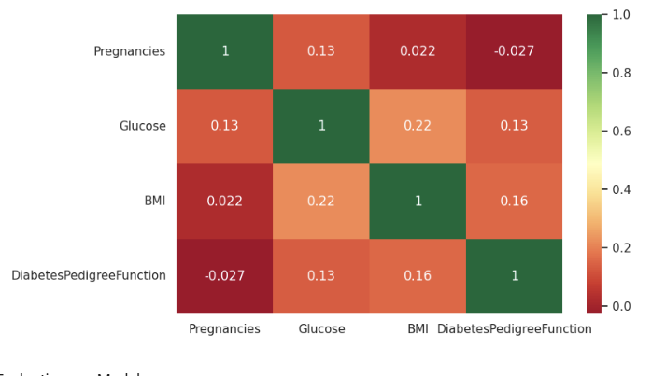
Visualize Logistic Regression

Slide 6
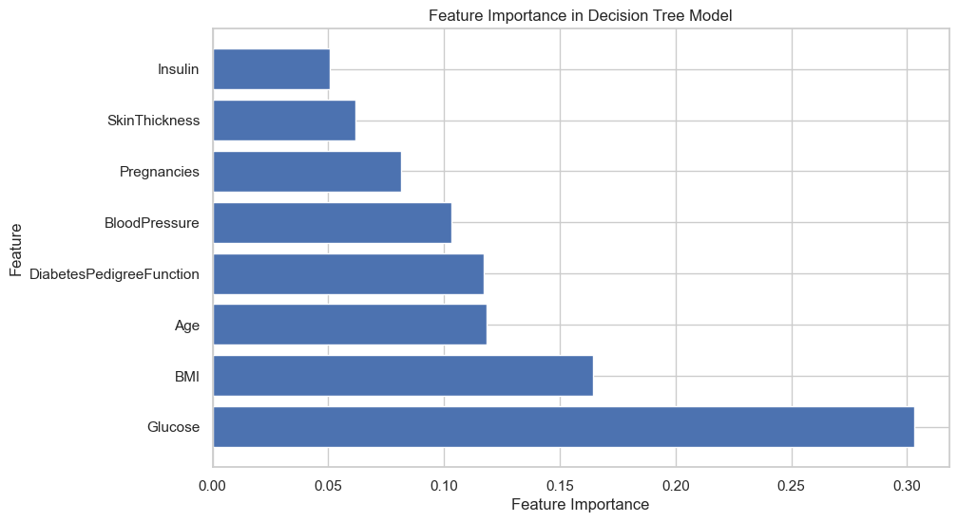
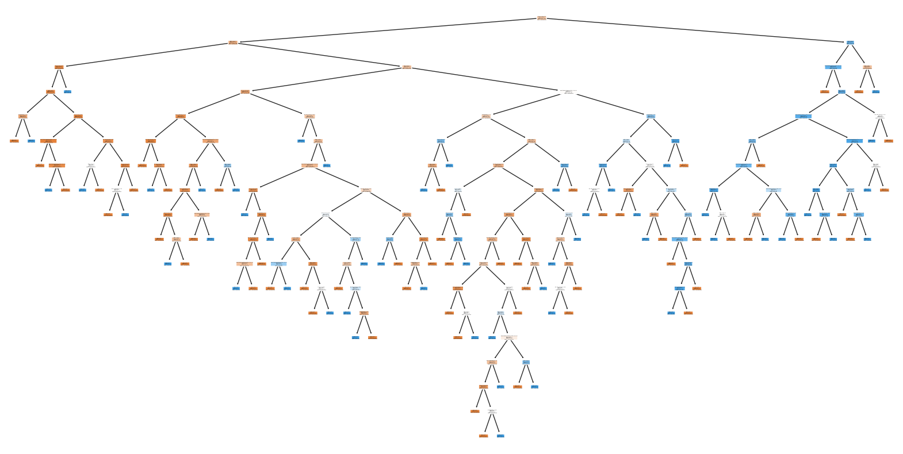
Decision Tree
A supervised learning algorithm used for classification and regression tasks. It represents decisions and their possible outcomes as a tree structure, with internal nodes representing features, branches showing decision rules, and leaf nodes indicating final predictions or outcomes.
Split data into training (70%) & testing (30%) Sets
Train the decision tree on the data
Assess decision tree performance
Evaluate decision Tree:
ROC Curve & Confusion Matrix
Explore feature importances
Visualize the full decision tree

Slide 7
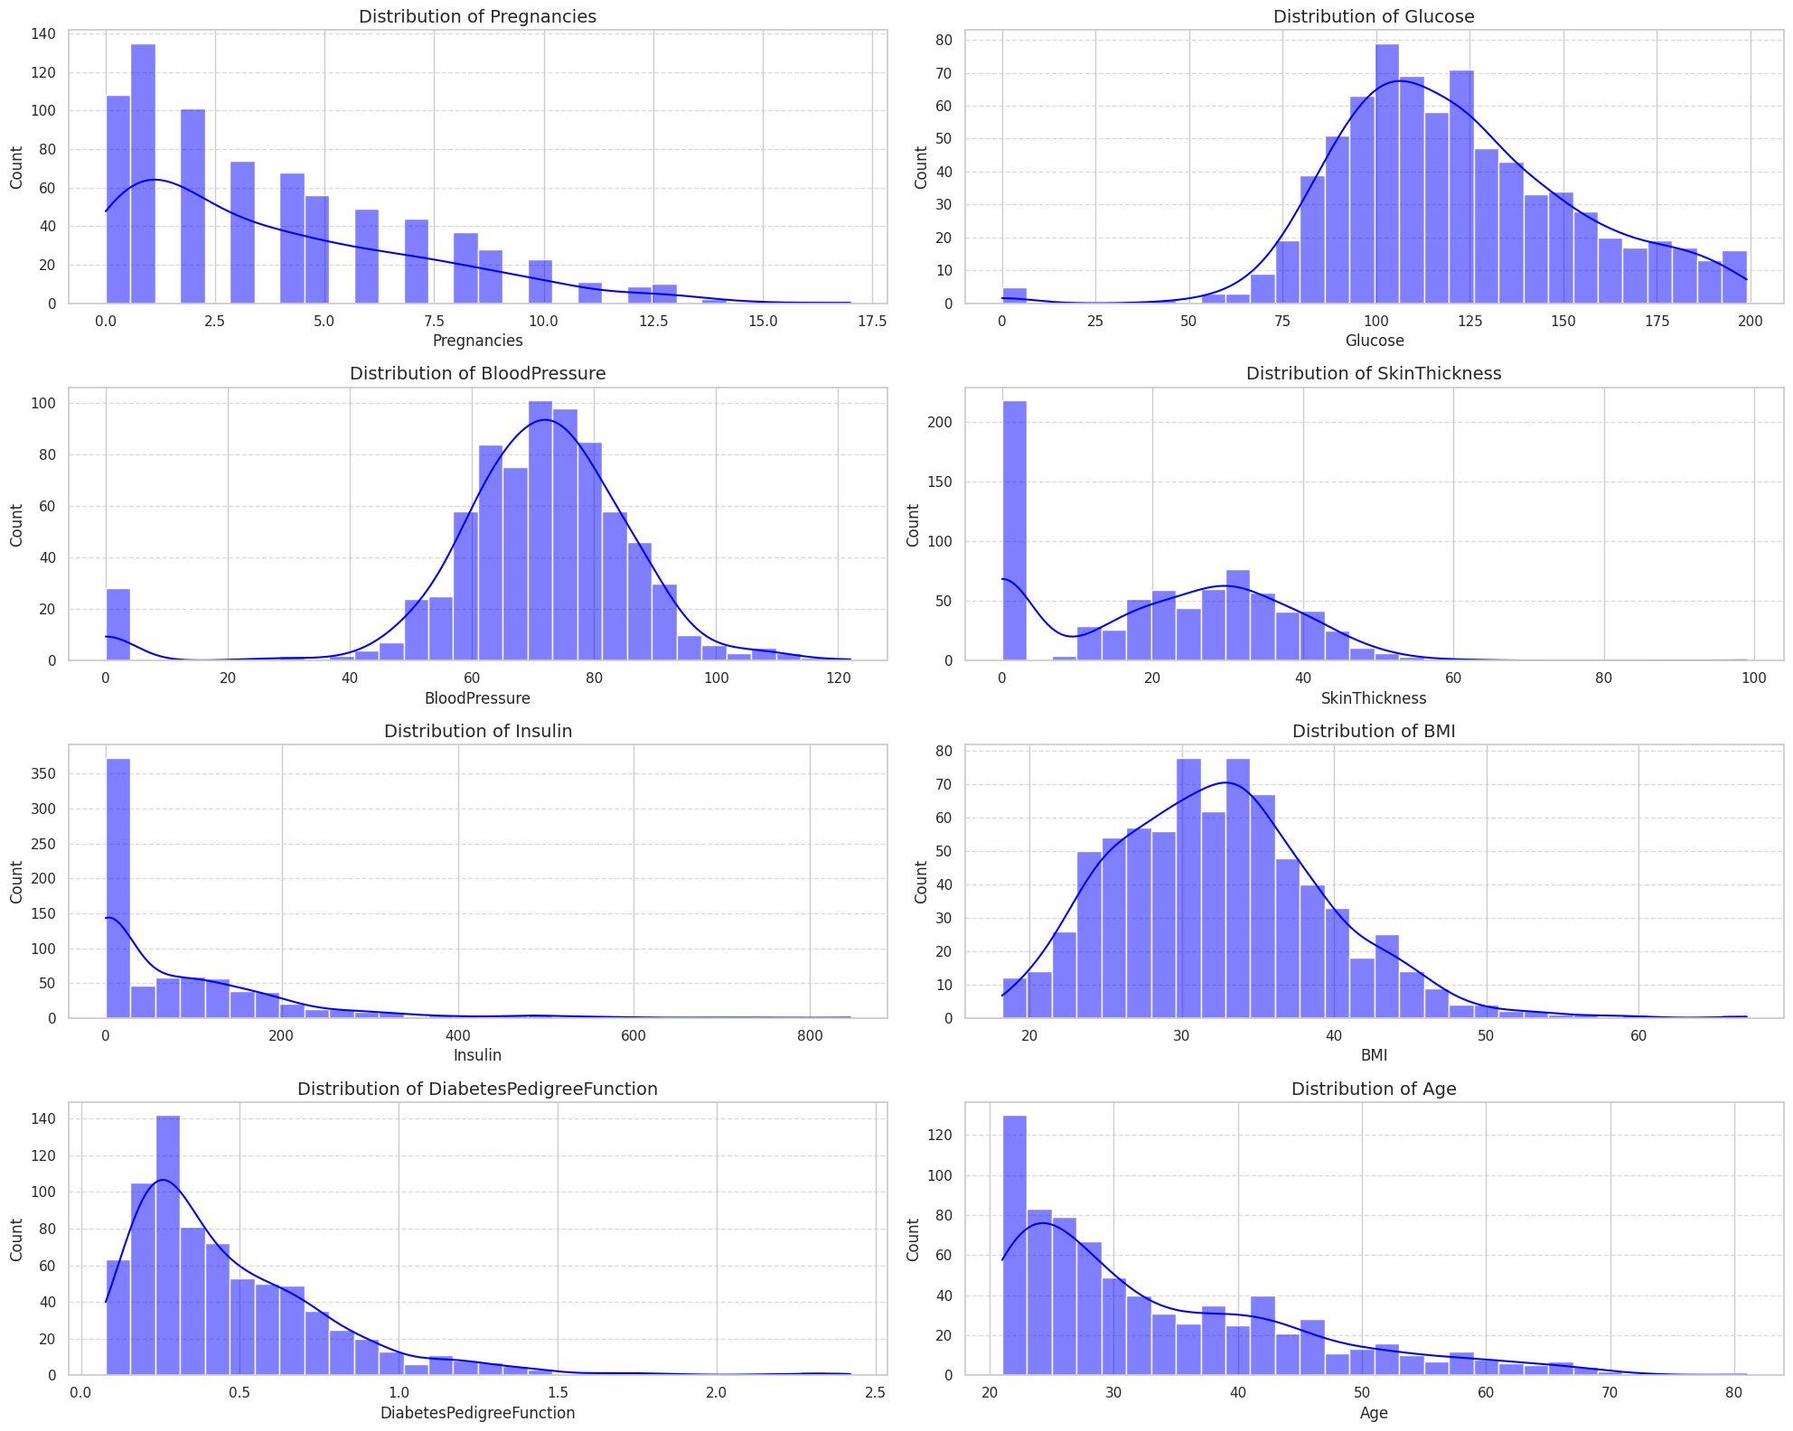
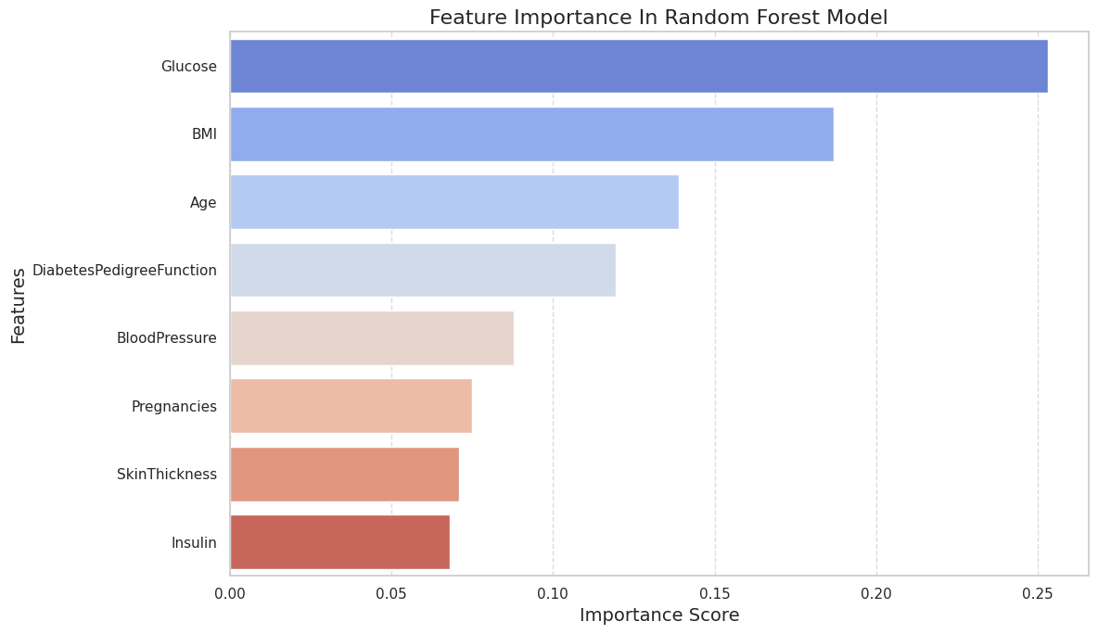
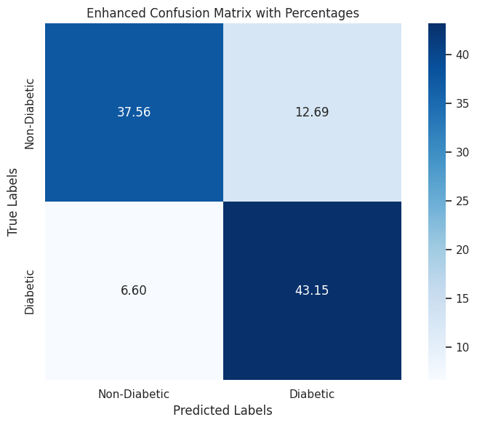
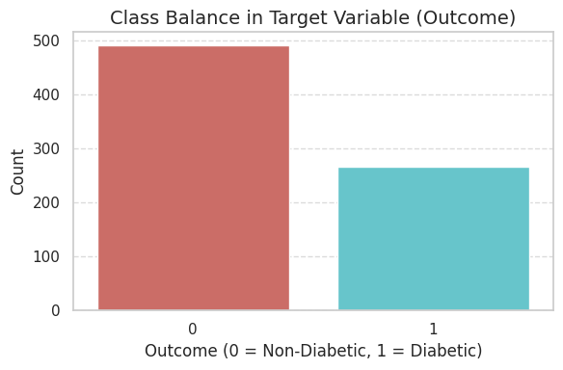
Random Forest
Feature Distribution:
Glucose & BMI: Near-normal.
Insulin & Skin Thickness: Right-tilted.
Feature Importance:
Top: Glucose, BMI, Age,
Least: Skin Thickness, Insulin.
Target Variable Distribution:
Class 0 (Non-Diabetic): Majority(500 samples).
Class 1 (Diabetic): Minority (268 samples).
Confusion Matrix Insights:
True Negatives: 37.56%
False Positives: 12.69%
True Positives: 43.15%
False Negatives: 6.60%

Slide 8
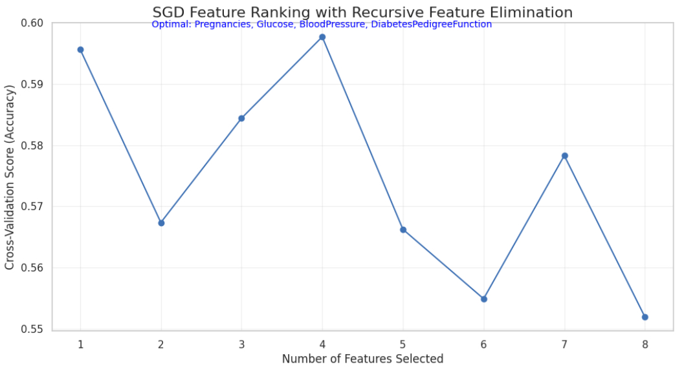
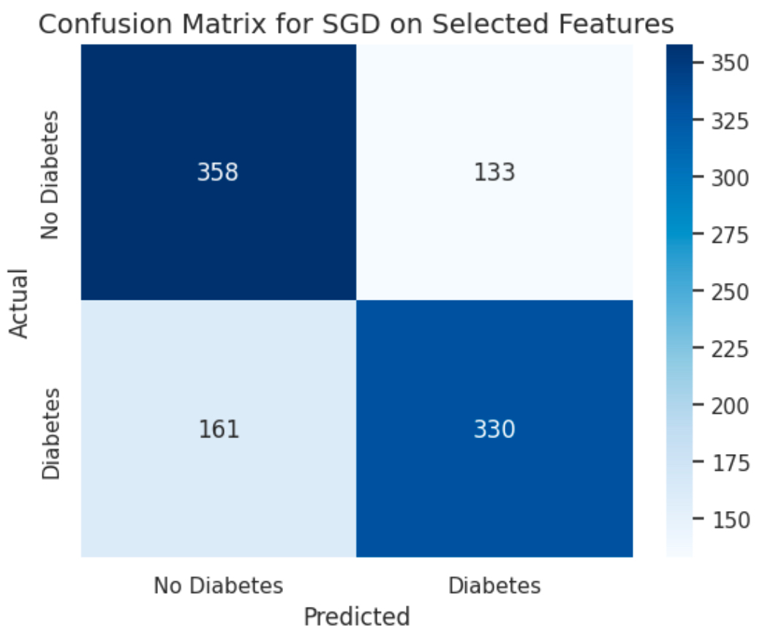
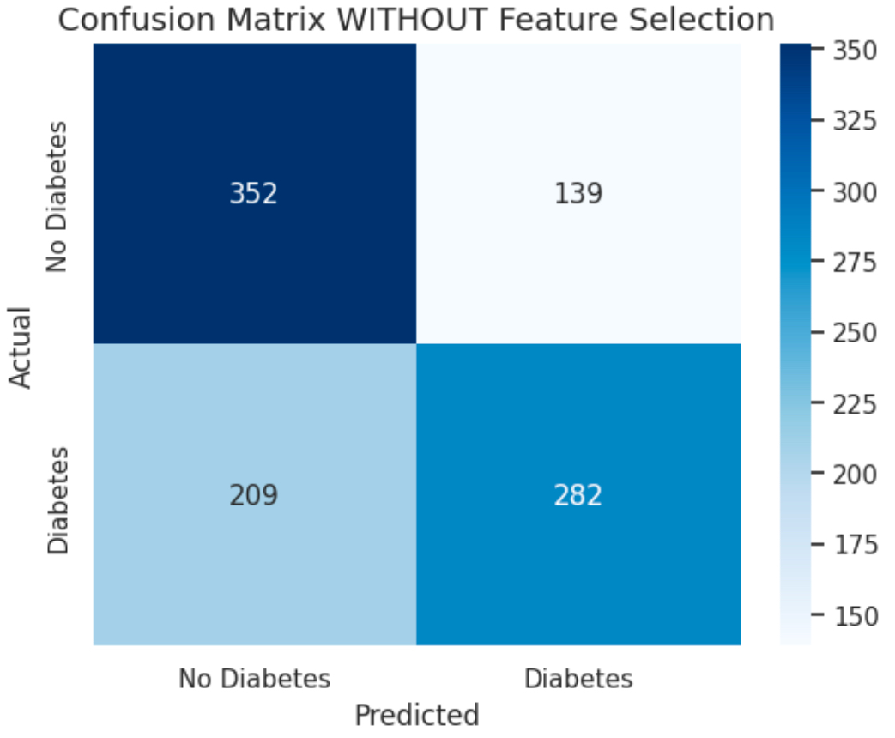
SGD - Stochastic Gradient Descent​
Feature selection using RFECV with SGD​
rfecv_sgd = RFECV(estimator=sgd_model, step=1, cv=kfold, scoring='accuracy', n_jobs=-1)​
rfecv_sgd.fit(os_data_X, os_data_y.values.ravel()) ​
SGD Model Result with feature selection: ​4 Selected features
​
Confusion Matrix WITH Feature Selection: [[358 133] [161 330]]​
True Positive (331): actual diabetes​
True Negatives (363): actual no diabetes​
False Positives (128): predicted diabetes ​
False Negatives (160): predicted no diabetes​
Confusion Matrix WITHOUT Feature Selection: [[352 139] [209 282]]​
True Positives (299): actual diabetes​
True Negatives (340): actual no diabetes​
False Positives (151): Predicted diabetes​
False Negatives (192): Predicted no diabetes​

Slide 9
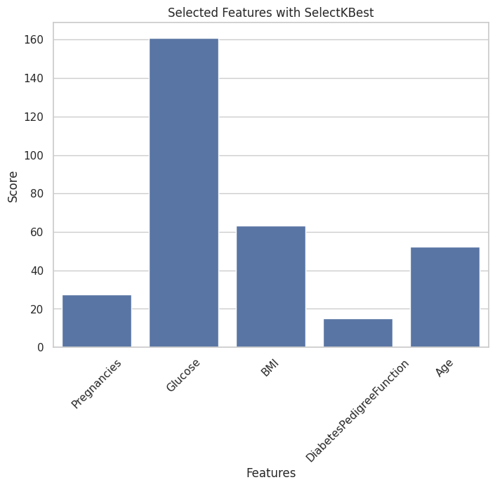
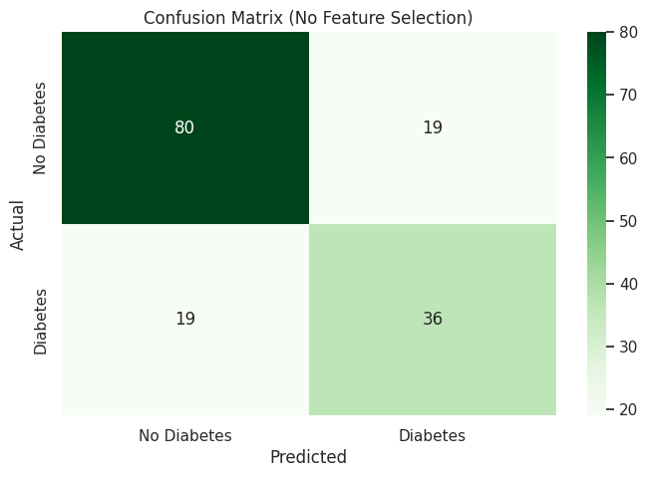
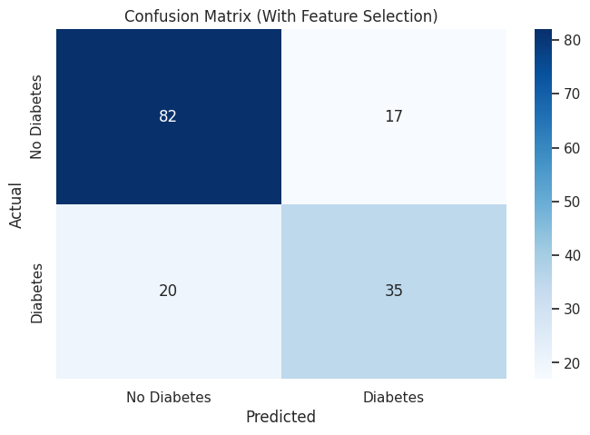
Support Vector Machine (SVM)
Overview-Imports the necessary libraries to load the dataset, preprocess the data, build the SVM model with and without feature selection, evaluate its performance and finally Visualization of model performance for each case .
Selected features with SelectKBest
It shows that the features "Glucose" and "BMI" have higher scores as compared to the other features.
This indicates that these two features are the most important predictors in the dataset.
The confusion matrix shows whether a patient has diabetes or not
True Positives (TP): 36-correctly identified 36 cases as "Diabetes."
True Negatives (TN): 80-correctly identified 80 cases as "No Diabetes."
False Positives (FP): 19-incorrectly predicted 19 cases as "Diabetes" when they were actually "No Diabetes."
False Negatives (FN): 19-incorrectly predicted 19 cases as "No Diabetes" when they were actually "Diabetes."
True Positives (TP): 35-correctly identified 35 cases as "Diabetes."
True Negatives (TN): 82-correctly identified 82 cases as "No Diabetes."
False Positives (FP):17-incorrectly predicted 17 cases as "Diabetes" when they were actually "No Diabetes."
False Negatives (FN):20-incorrectly predicted 20 cases as "No Diabetes" when they were actually "Diabetes."
The model seems to perform well overall, as the diagonal values (correct predictions) dominate the confusion matrix but can be improved(accuracy 75%).
Feature selection improved the model's accuracy.Indicating that selecting the most relevant features for the model likely reduced noise or irrelevant data, leading to better overall performance(accuracy 76%).

Slide 10
GridSearchCV Tuning
This slide presents a comparison of the performance of several machine learning models—Logistic Regression, Decision Tree, Random Forest, SGD, and SVM—along with their cross-validation and test accuracies. The table highlights the results before and after tuning with GridSearchCV, which is used to find the best hyperparameters for each model.
Logistic Regression demonstrated consistent cross-validation (76.88%) and test accuracy (76.62%), making it the most stable and well-performing model after tuning. It is a strong baseline model with reliable generalization.
Decision Tree showed a minor improvement in test accuracy (75.97%) over cross-validation accuracy (74.11%), suggesting good performance on unseen data and a slight sensitivity to the test set.
Random Forest achieved the highest cross-validation accuracy (78.51%) but had a notably lower test accuracy (75.32%). This indicates that while the model fits well to the training data, residual overfitting remains despite tuning.
The SGD classifier had a cross-validation accuracy of 74.27% and a test accuracy of 74.68%. While slightly below Logistic Regression, it showed stability and good generalization, making it a competitive option for linear models.
The SVM model achieved a cross-validation accuracy of 76.55% and a test accuracy of 75.32%. Its performance was comparable to Logistic Regression, making it a robust alternative model, especially for smaller datasets or high-dimensional data.
Model | Cross-Validation Accuracy (%) | Test Accuracy (%) | Difference (Test - CV) (%)
Logistic Regression | 76.88 | 76.62 | -0.26
Decision Tree | 74.11 | 75.97 | +1.86
Random Forest | 78.51 | 75.32 | -3.19
SGD Classifier | 74.27 | 74.68 | +0.41
SVM | 76.55 | 75.32 | -1.23
Approach:
For each model, I used GridSearchCV to tune hyperparameters by specifying a range of values for key parameters, such as regularization strength for Logistic Regression, the number of estimators for Random Forest, and the depth of the tree for Decision Trees. I performed 5-fold cross-validation to evaluate the performance of each hyperparameter combination, aiming to identify the best settings that maximized accuracy while minimizing overfitting. This process helped optimize each model for improved generalization on unseen data.

Slide 11
You can also split your content
Advantages Disadvantages
Each model brings unique advantages based on its characteristics:
Logistic Regression is simple, interpretable, and performs consistently, making it a reliable baseline with minimal overfitting.
Random Forest excels at handling complex relationships and identifying feature importance, offering robust performance for high-dimensional data.
Support Vector Machine (SVM) is powerful for small or high-dimensional datasets, with feature selection and proper kernel selection further enhancing its accuracy.
Stochastic Gradient Descent (SGD) is efficient and scalable for large datasets, especially when paired with feature selection to reduce noise.
GridSearchCV tuning optimizes hyperparameters, enhancing model performance and stability by systematically evaluating different configurations across a predefined grid of parameters.
Together, these models provide a range of options, balancing interpretability, computational efficiency, and predictive power, depending on the dataset and application requirements.
Each model also has its limitations:
Logistic Regression struggles with capturing non-linear relationships, which can limit its performance on complex datasets.
Random Forest is prone to overfitting, particularly with small datasets, and can be computationally expensive.
Support Vector Machine (SVM) is sensitive to hyperparameter tuning and can become computationally intensive for large datasets.
Stochastic Gradient Descent (SGD) is highly sensitive to hyperparameter settings and often suffers from poor recall and high false negatives without proper optimization.
Despite GridSearchCV's tuning capabilities, the process can be computationally expensive, particularly for large datasets and complex models with many hyperparameters.
Across all models, handling high false negatives remains a challenge, especially in critical contexts like medical diagnoses, where missing a positive case can have severe consequences.
White
Is the color of milk and fresh snow, the color produced by the combination of all the colors of the visible spectrum.
Black
Is the color of coal, ebony, and of outer space. It is the darkest color, the result of the absence of or complete absorption of light.

Slide 12
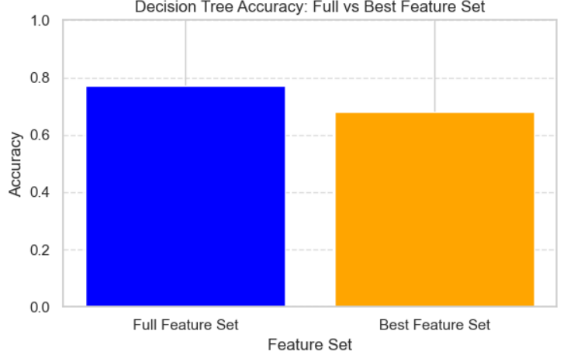
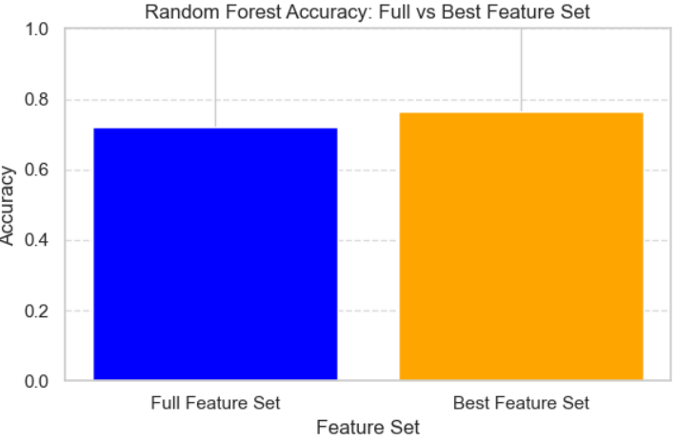
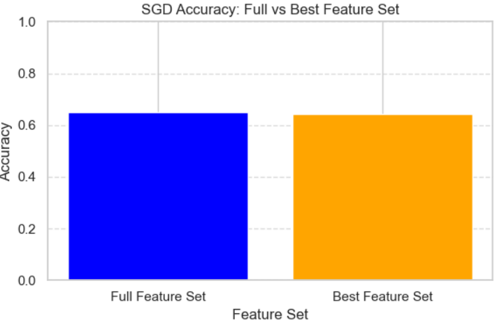
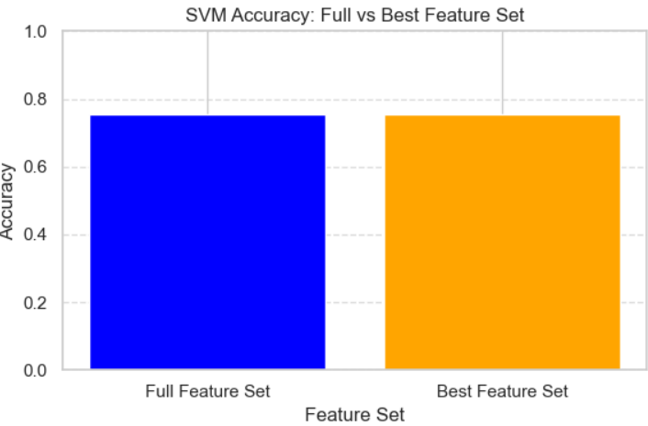
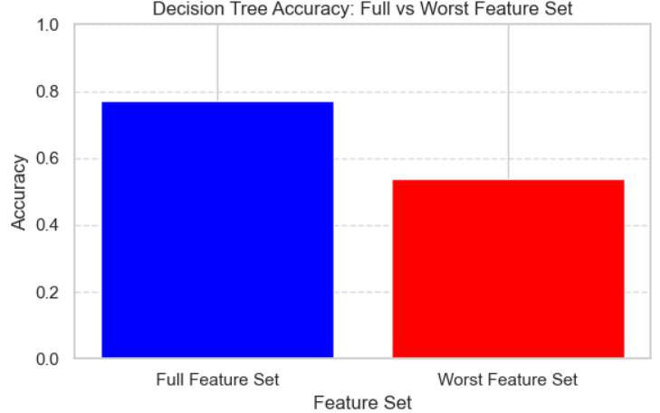
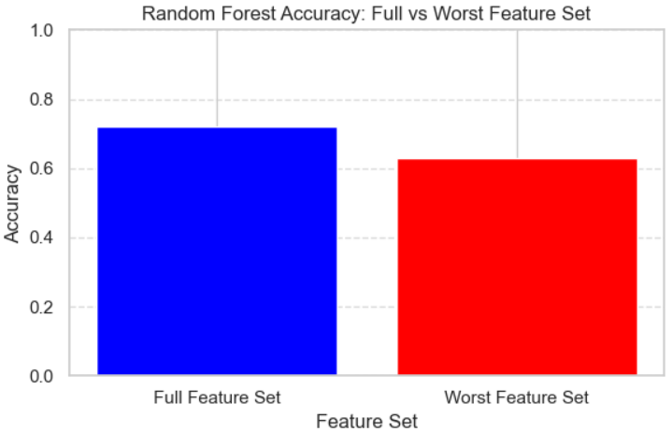
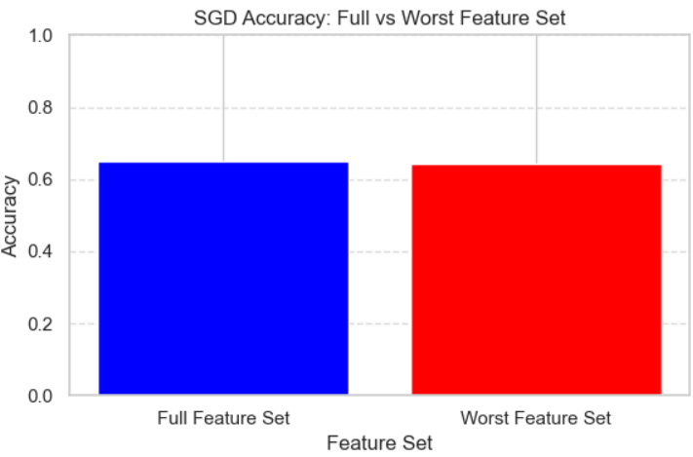
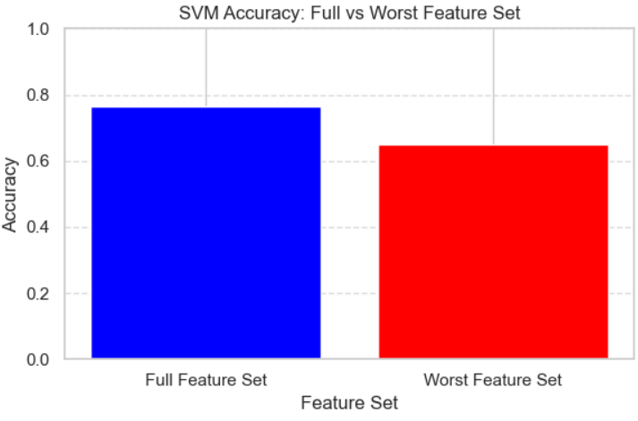
Feature Removal

Slide 13
Feature Removal
DT decrease might indicate that with the decrease of features, it became too small to find the patterns needed to properly be accurate.
RF increase might indicate that the other features caused the inherent randomness of the RF model to be more inaccurate.
SGD decrease might indicate that some features might have been removed during feature selection, a lack of features selected which made it insufficient to provide an accurate data.
SVM showed no change which might indicate that the features is enough for the SVM and due to its strength to unimportant features, selecting the best showed no impact to its training.
All models showed a decrease in accuracy which is to be expected when the best features were removed which will cause more possibility of irrelevant features to be used more frequently. The overall decrease of features might also indicate that the amount of features used is too low to create accurate models
DT showed the most noticeable decrease (around -0.24) which can be inherent in its reliant on needing features that create good splits.
RF showed a decrease (around -0.1).
SGD showed a minimal decrease (around 0.007) which is not as much decrease as expected since SGD uses gradients which are quite dependent on certain prominent features to function properly. This might be indicative as to why accuracy on the original model is lowest to begin with.
SVM showed a decrease (around 0.12)

Slide 14
Conclusion
The project explores various machine learning models to predict diabetes, emphasizing the importance of feature selection, evaluation metrics, and hyperparameter tuning. Each model has its strengths and weaknesses, and the performance is highly dependent on the dataset's characteristics and preprocessing techniques applied.
Logistic Regression emerged as the most stable and well-generalizing model, providing reliable performance across both training and testing data. GridSearchCV tuning helped optimize parameters such as C (regularization strength) and penalty (e.g., L1 or L2), further boosting performance.
Random Forest achieved the highest cross-validation accuracy, demonstrating its ability to fit the data well. However, it showed signs of overfitting on the test set. GridSearchCV tuning for n_estimators, max_depth, and min_samples_split balanced performance and reduced overfitting.
Support Vector Machine (SVM) and Stochastic Gradient Descent (SGD) models benefited significantly from feature selection techniques like RFECV and SelectKBest, reducing noise and improving accuracy. For SVM, GridSearchCV helped identify the optimal kernel (linear or rbf), C, and gamma values, enhancing predictive accuracy. For SGD, hyperparameter tuning using GridSearchCV for learning_rate, penalty, and alpha stabilized performance.
Feature Selection methods like RFECV and SelectKBest played a crucial role in enhancing model performance, especially for linear models such as Logistic Regression and SGD.
The high false negatives observed in some models (e.g., Random Forest, SGD) highlight a critical limitation, especially for medical applications like diabetes prediction, where missing a diagnosis can have serious consequences. Hyperparameter tuning via GridSearchCV and recalibrating class weights proved effective in mitigating this issue.
Ultimately, the combination of feature selection, robust evaluation, and GridSearchCV for hyperparameter optimization allowed for a more tailored approach, ensuring that the models were not only accurate but also reliable and interpretable.

Slide 15
Thank You.
Group Members:
PRATHAM SAPRA : 101572630
BISHAKHA : 101547832
HENSEL MARVI AGGARAO : 101544174
NAHID NASERI : 101518575
VRUNAL PATEL : 101574257
JAMES DOMINIC BELIZARIO : 101396978
STEPHEN LU : 100646328
BHOOMIKA PATEL : 101595094
ADAM DANIEL JENAH : 100970401
Any questions?

